Slide 1
DL Knowledge and Skills A slide to remind me what to include
Photo, charts table and short story based units
Initial Q in English and answer lines or tables in English
Evidence in single or multilingual EU languages
Implementation: Units can be TAUGHT ( eg whiteboard + group/pair activities OR : used for assessment
Teacher notes below slides and in folder
Pupils’ activities can be used for portfolio
Intent: reinforcing understanding and use of key language learning terminology and concepts: potential for assessment
Impact: summarising knowledge prior to KS3
1.articles (and gender)
2. nouns
3. Singular plural
4. verbs and simple tenses
5. adjectives (and agreement) .
6 connectives (maybe conjunctions?)
7. prepositions
8. word order
9. cognates
10. dictionary use
11. patterns especially in number systems
12. punctuation
13. phonics and alphabet similarities and differences
14. Language families especially Germanic and Romance (Latinate?) What else?

Slide 2
DL: Multilingual ‘language discovery’ units for upper KS2 Teacher’s notes: P1
DL multilingual language discovery units can be used as :
Whole class whiteboard lessons followed by individual/ pair or group activities
Activity slides can be printed off as worksheets
Individual/ paired assessment or portfolio activities, using PPt on ipads/laptops
A combination of both a and b
The rationale of using multi-lingual documents
English is a language with both Germanic and Romance vocabulary as well as Latin, Greek and world language influences
Upper KS2 pupils, in particular those who are either bilingual or have already studied more than one foreign language following the DL approach ( www.discoveringlanguage.co.uk) will have developing skills and knowledge to decode small texts in other languages
Pupils’ knowledge of English can inform their learning of new languages by looking for the similarities in languages, as well as noting key differences.
Similarities to note (at upper KS2 level) :
using cognates (word cousins) and context to extract information
recognising familiar SPAG patterns eg punctuation plurals and determiners
recognising parts of speech eg. nouns, adjectives and verbs
recognising Germanic and Romance influences on our English vocabulary
Differences to note (at upper KS2 level)
Word order , in particular with adjectives
Gender patterns
Accents and unusual letter combinations

Slide 3
DL: Multilingual ‘language discovery’ units for upper KS2 Teacher’s notes: P2
Key instructions and titles
These are in English, to establish the context and required activities
Document evidence : languages used
To maximise the possibilities of looking for cognates, the main languages used are: Romance French, Spanish and Italian (Romance) and German (Germanic)
Other EU languages are occasionally used where appropriate eg: Dutch, Danish, Norwegian, Swedish, Portuguese
Languages with different script are not used for the ‘discovery’ purposes of these documents
Extension possibilities
Classroom teachers may well see possibilities for extension activities in other curriculum areas: eg English factual and creative writing,, geography, art, design etc
Classrooms with EAL pupils may find opportunities to look at the same vocabulary in EAL pupils’ home languages: what are the similarities and differences?
Intended outcomes
Working with several languages:
pupils can develop an understanding of how ‘language’ (rather than foreign languages) has many aspects that are already familiar to them:
pupils will understand that all languages allow us to communicate about the world through words and texts, with some similar and some different vocabulary and rules to English,
embeds and reinforces pupils’ understanding of English SPAG
widens and deepens vocabulary
enhances motivation and a desire to learn more about these particular languages, or new ones!
can reduce that (very English!) fear of other languages, dispelling strangeness and embracing new horizons

Slide 4
DL :
Language Discovery Unit 1
ALLPPT.com _ Free PowerPoint Templates, Diagrams and Charts

Slide 5
A. How did the rhinoceros get his name?
DOCUMENT A
Etymological dictionary
Activity A: The word rhinoceros comes from which two original words, and which original language?
 | Original word | Original meaning | Original language
1
2
Notes:
Skills: interpreting an etymological dictionary

Slide 6
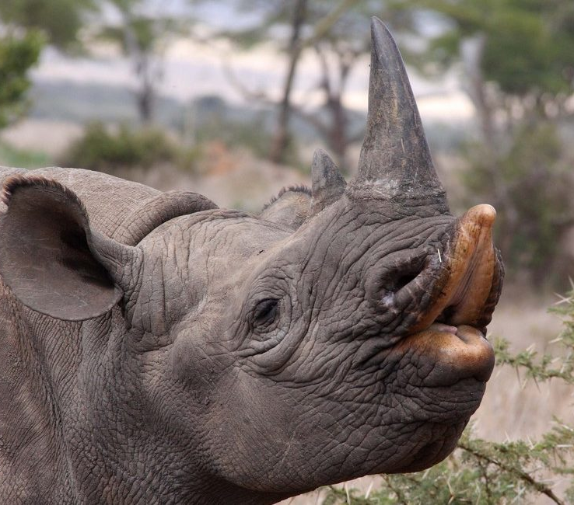
DOCUMENT B1 : translations
French | rhinoceros
German | Nashorn
Dutch | neushoorn
Portuguese | rinoceronte
Danish | naesehorn
Bulgarian | nosorog
Polish | nosorozec
Italian | rinoceronte
Spanish | rinoceronte
Norwegian | neshorn
Swedish | noshorning
Welsh | rhinoseros
Icelandic | nefkok
Finnish | sarvikuono
DOCUMENT B2: German/English dictionary
German | English
Nase | nose
Horn | horn
B1:
Rhinos
in EU
languages
Notes:
Note : some accents and umlauts missing
Should I put definite articles? Perhaps not as its not the point of this exercise
Note: Id like a real dictionary entry for Nashorn but cant find an easy enough one…( not full of unwanted text)

Slide 7
Activity B1 : write the correct rhinoceros translation on the correct country
B1a:
Rhinos
in EU
languages
Notes:
Skills: identifying EU countries. Accurate transcribing

Slide 8
B2:
Rhinos
in EU
languages
Activity B2: Look at your map of Europe with translations for rhinoceros.
Can you see a pattern in the words? Can you divide the words into two groups? Use some colour to show this clearly on the map
Explain the pattern in a sentence using the words ‘Germanic’ and ‘Romance’ …………………………………………………………………………………………………………………………………… …………………………………………………………………………………………………………………………………… …………………………………………………………………………………………………………………………………..
Notes:
Showing understanding of Germanic and Romance language patterns in Europe

Slide 9
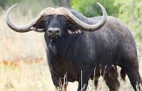
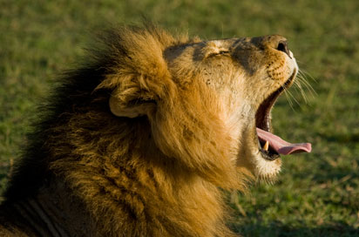
C1: The Big Five
DOCUMENT C: SHORT TEXT This German article mentions the BIG FIVE animals to look out for in Kenya The Big Five were the animals most valued for big game hunting in the early twentieth century See hidden pictures for clues
Die Rhino Watch Safari Lodge bietet durch die ideale Lage den Augangspunkt für Game Drives, Wanderungen und Naturbeobachtungen. Alle großen afrikanischen Wildtiere können auf dieser Safari beobachtet werden. Elephanten, Löwen, Leoparden, Büffel und Nashörner stehen auf dem Programm
Activity C1: Find the German names for the Big Five and give the English translations Note: the German words are plurals
German | English
Notes:
Using cognates and context
Hidden pictures can be revealed by sending chart to back!

Slide 10
C2: The Big Five
Activity C2: The Big Five questions…
How did you decide on the translations for the Big Five? Helpful words to use: cognates, context, dictionary, clues
2. Can you find three different English cognates in the German text?
1. 2. 3.
3. What is the name of the safari lodge? Why do you think the name is not translated into German?
4. Copy one punctuation mark and one alphabet letter that are used in German but not in English.
5. Elephanten, Lowen and Leoparden are plurals, but there is no ‘s’ at the end. What two letters are used for the plural form of these words?
Notes:
Extension Qs about big 5 text.

Slide 11
C3: The Big Five
Activity C3: Each of the big five are mentioned 5 times below in 5 languages! French, German, Dutch, Italian , Spanish Sort out the words and languages and place them on Activity C4 chart
neushoorn | buffle | Löwe | bufalo | olifant
búfalo | rhinocéros | leeuw | Leopardo | Elefant
león | Leone | elefante | rinoceronte | rinoceronte
éléphant | luipaar | leopardo | buffel | Leopard
elefante | Nashorn | léopard | lion | Büffel
Notes:
Differentiating between languages ???? Should we use definite or indefinite articles ( determiners?) here?

Slide 12
C4: The Big Five
English | lion | buffalo | elephant | rhinoceros | leopard
French
Italian
Spanish
German
Dutch
Activity C5:
Which language begins nouns with a capital letter?
Which three languages use accents above letters?

Slide 13
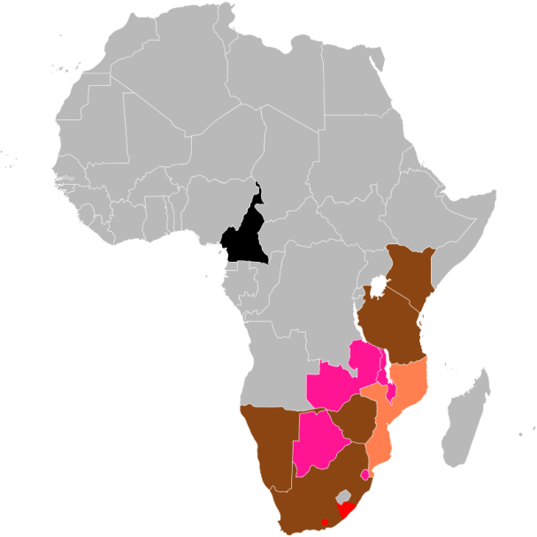
D1: Where do black rhinos live?
DOCUMENT D: Interpreting a map
This map is from Wikipedia and gives information about the areas where black rhinos now live in Africa
The coloured key is translated in both Spanish and Italian
Activity D | Use the Italian and Spanish keys to make an English translation
Key | Italian | Spanish | English
 | areale originario | nativo
 | reintrodotto | reintroducido
 | introdotto | introducido
 | presenza incerta | posiblemente extinto
 | estinto | extinto
Notes:
Using Italian and Spanish cognates to interpret a map

Slide 14
E1:
Headlines
Chiara:
Dobbiami salvare i
rinoceronti
Amy:
We must save rhinos
Hans:
Wir müssen
Nashörner
retten
Carmen:
Debemos
salvar a los
rinocerontes
Pierre: Il faut
sauver les
rhinocéros
Activity E1: Looking for verbs and phrases
1. Who is saying the same as the newspaper headline?
2. Which words are similar to ‘we must’ in English
3. Find the 4 verbs ‘to save’:
4. Which part of the English phrase is Germanic?
5.Which part of the English phrase is similar to the Romance languages (Fr, Es, It)
Notes:
Look back at first pages translations of rhino to work out the languages. Note these are now plurals
knowledge of cognates; context, plurals, word order

Slide 15
DOCUMENT E: Interpreting headlines
…from the World Wildlife Fund multi-lingual websites
wwf.fr wwf.de wwf.it wwf.es
E2:
Headlines
Notes:
Note: in Vietbnam: they wrongly think rhino horn ( a type of nail) is a cure for cancer and other diseases ( not used as an aphrodisiac!)

Slide 16
E2:
Headlines
Activity E2:
Match the headlines and languages with the images
Write a new, and equally strong, headline in English!
Just to make my horn into ashes, my whole species will be
pulverised
Her life is not
worth a horn
French
Italian
Spanish
German
Horns worth the price of gold
Victims of superstition: their horns are suppose to have
powerful healing properties
Notes:
Note: in Vietnam: they wrongly think rhino horn ( a type of nail) is a cure for cancer and other diseases ( not used as an aphrodisiac!)

Slide 17
E3:
Headlines
Activity E3: Calculate and answer…
How much is rhino horn worth compared to gold?
How many rhinos remain altogether in the world?

Slide 18
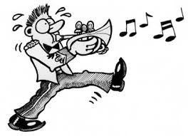
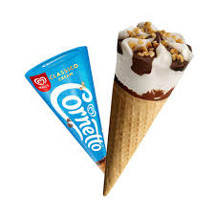
DOCUMENT F
F:
Word
Friends?
English | horn
German | Horn
French | corne
Italian | corno
Dutch | hoorne
Spanish | cuerno
Swedish | horn
Latin | cornu
Activity F:
Brainstorming: looking for word
patterns

Slide 19
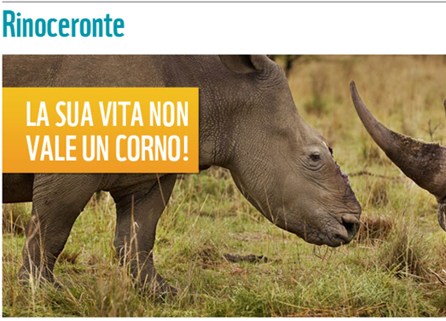
F:
False
Friends?
Watch out for false friends!
Sometimes words in other languages look like English: but they are just the same letters with a different meaning!
Examples:
German: Art = species or type
Italian: = is worth

Slide 20
G1: Rhino facts
DOCUMENT G: Spanish
Rinoceronte nero Rinoceronte blanco
DOCUMENT G: Italian
Peso
775-1350 kg
Peso
1800-2500 kg
Altezza
1.3-1.6m
Altura
1.5-1.9m
Lunghezza
2.5-3.0m
Largo
3.8-4.8m
Activity G1: use the Italian and Spanish document to work out some rhino statistics …
 | Height | Length | Weight
Black rhino
White rhino

Slide 21
Make a slide based on white and black. Nero blanco?

Slide 22
G 2: Extra Rhino Facts
How many facts can you translate?
Nashorn
weiße sind
eigentlich grau
German
Activity G2: Choosing from several languages
What colour are white rhinos really?
Why were they mistakenly called white?
What part of their body is keratin?
What parts of our bodies are keratin?
Are white rhinos more or less social than black rhinos?
Deres horn er lavet af keratin, de samme ting som vores negle og hår Danish
Ils sont l'espèce de rhinocéros la plus sociale
French
Early English-speaking settlers in South Africa misinterpreted the "wijd" for "white" and the rhino with the wide mouth ended up being called the white rhino

Slide 23
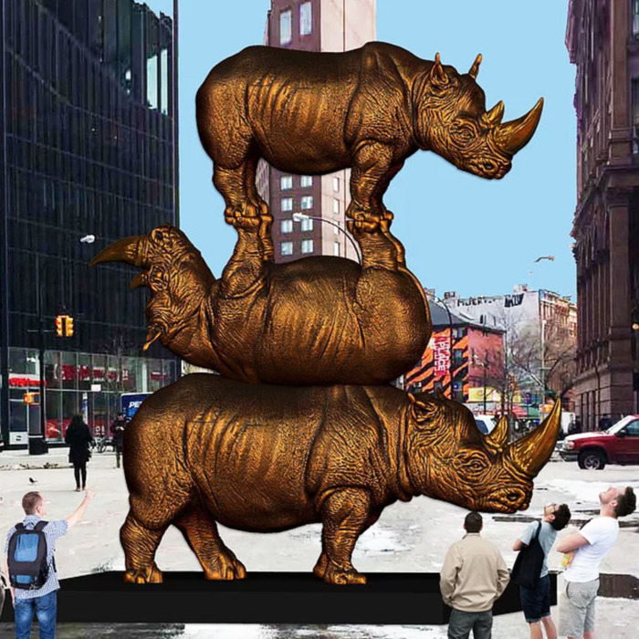
H: Rhino Culture: Sculpture!
DOCUMENT H1
Une grande sculpture à New York pour immortaliser les derniers rhinocéros blancs
Activity H1:
Can you translate the title to this photograph?
How many French/English cognates can you find?
Notes:
Note: This is to commemorate the last 3 northern rhinos in Kenya: The male, Sudan, died in 2018; two females only remain

Slide 24
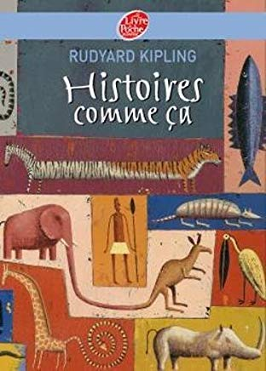
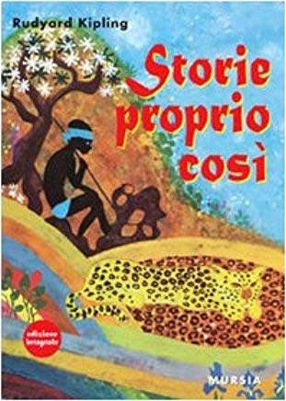
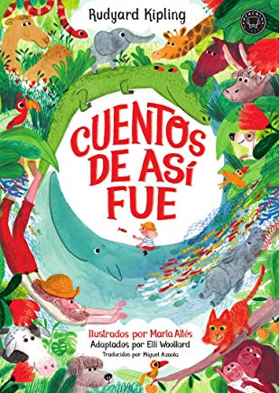
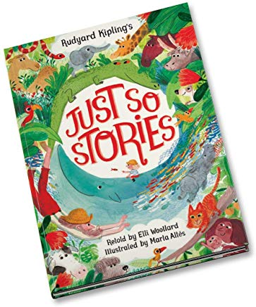
H2: Culture: Stories
DOCUMENT H2: The Just So Stories

Slide 25
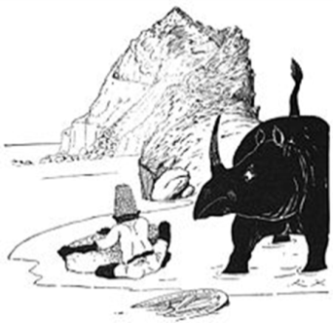
H: Rhino Culture
Activity H2: The Just So Stories (Rudyard Kipling 1902) have been translated into many different languages
The Rhinoceros story title has been split in two!
Join them up and match with the Just so Story title too
Read the story in class in English; the vocabulary is rich and ambitious!
German Genau-so-Geschichten | Así fue cómo al rinoceronte | ebbe la sua pelle
English Just So Stories | Wie das Nashorn | se le formó su piel
French Histoires comme ça | Come il rinoceronte | se fit sa peau
Italian Storie proprio cosi | How the Rhinoceros | seine Runzeln bekam
Spanish Cuentos de asi fue | Comment le Rhinocéros | Got His Skin

Slide 26
H: Rhino Culture
Así fue cómo al rinoceronte se le formó su piel | explique pourquoi le rhinocéros a la peau ridée et une âme irascible
Wie das Nashorn seine Runzeln bekam | spiega perché il rinoceronte ha la pelle rugosa e l'animo irascibile
Come il rinoceronte ebbe la sua pelle | explica por qué los rinocerontes tienen malos genios y arrugas en la piel.
How the Rhinoceros Got His Skin | warum Nashörner Hautfalten und schlechte Laune haben
Le Rhinocéros et sa peau | why rhinos have folds in their skin and bad tempers

