Slide 1

Shh … !
Can we communicate without making a sound?
Notes:
It will depend on your class whether you can move straight into this discussion: what does ‘ communicate’ mean?
perhaps begin the lesson without talking and just mime to the pupils?
Maybe prime one group of pupils beforehand so they know how to respond to you!

Slide 2




1. Can faces ‘talk’? What might these emojis be saying?
Print out one per pair
Notes:
Pupils can work in pairs/small groups to decide what the 4 emojis are saying. Bring up the word ‘communicate’. Print a copy of the slide for each pair. Feedback: how did pupils decide what to write? Were there any big disagreements or are these facial expressions very clear…and universal?

Slide 3
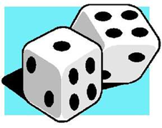
Activity 2a: Throw the die and mime the number
 | Let the die choose the number Do the mime for your partner
1 | Sadly say ‘goodbye’ to a friend
2 | Happily say hello to a friend
3 | Eat something you DON’T like
4 | Eat something you DO like
5 | Hear really good news
6 | Hear really bad news
Notes:
Play a SILENT pairs game with 6 sided dice. A throws and mimes: B guesses ( by showing fingers for numbers)

Slide 4
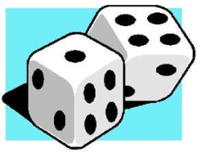
Activity 2b: Throw the die and mime the number
 | Let the die choose the number Do the mime for your partner
1 | You have no idea what is going on!
2 | You don’t agree with someone
3 | You see something really scary!
4 | You really don’t want to do something
5 | Think about something really hard
6 | You are really tired and ready for bed
Notes:
A slightly harder set of mimes…

Slide 5
3: Match the country with the non-verbal communication!
Click slide for answers: The 1st letters of the correct answers will spell out a wild animal!
Here putting both hands in your pockets can be disrespectful!
ENGLAND
Here, a moving finger on the cheek means something is tasty
TURKEY
Here nodding your head can mean ‘ NO!’
ITALY
Here rubbing your tummy means something is tasty
RUSSIA
Here people may clap hands
when meeting someone
GREECE
Notes:
This needs to be made interactive. …to lead a discussion that some gestures change meaning in different countries!
NB on the whole there are more common gestures between countries than different ones but it can be fun to notice the difference

Slide 6
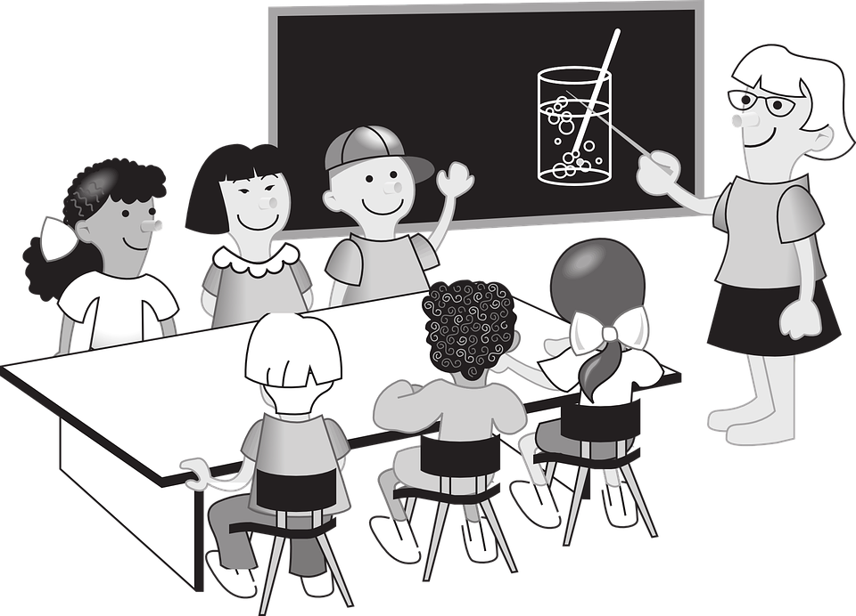
Notes:
Could this situation work using no spoken language …only non-verbal communication/body language? With difficulty: You would need to know lots of signs…but what if one of the children was deaf? See what pupils already know about deaf signing…. Do any pupils know anyone who signs? Stress that the deaf community consider this to be a real language.This is an ideal opportunity to invite a signer in to the school

Slide 7
4a: in pairs make up 2 word phrases using BSL eg: blue car
 | RED
 | BLUE |  | CAR |  | BOAT
 | PURPLE |  | HAT |  | AEROPLANE
 | GREEN |  | BUTTERFLY |  | CUP
 | YELLOW |  | BALL |  | FISH
 | ORANGE |  | TEDDY |  | DUCK
Notes:
NB Sign language can differ from country to country and even have dialects.
Pupils can play a game in pairs: one signs a colour+ noun: the other guesses. See next slide for more signs to extend the activity

Slide 8
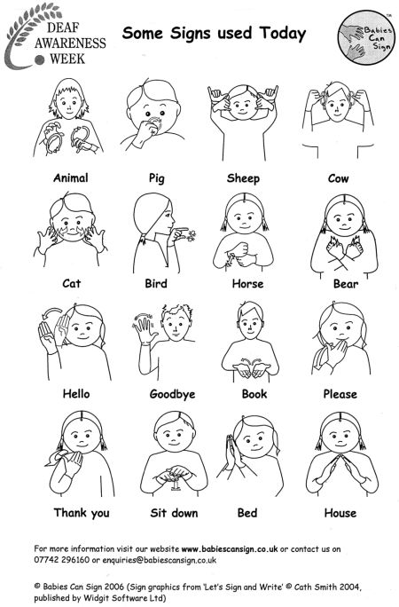

Slide 9
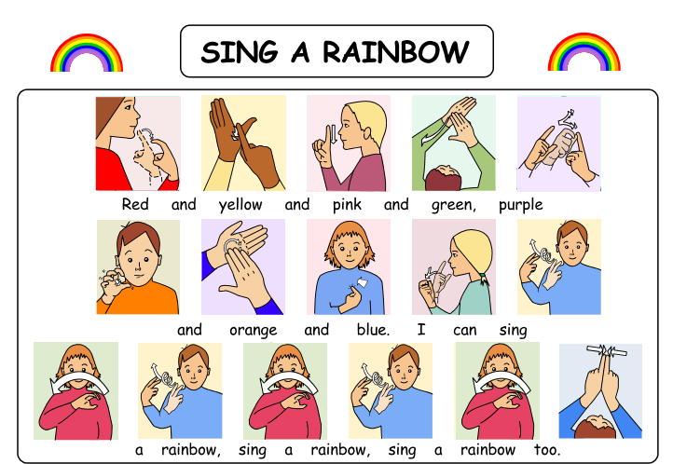
4b
Notes:
4b: Slide 9: has a signed version of ‘Sing a Rainbow’. This could be a good assembly activity. For the complete signed song, see the free download from www.deafbooks.co.uk

Slide 10
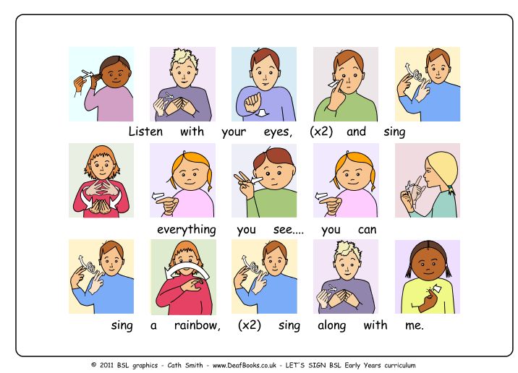

Slide 11
A1: DISCOVERING LANGUAGE PEER ASSESSMENT
Your name Partner’s name
I can remember the following 5 BSL signs
1.
2.
3.
4.
5.
(show the signs to your partner)
An example of when I use body language is when I ……………………………………………………………………………..
An example of when my partner uses body language is when … ……………………………………………………………………………..
Work with a partner to complete the speech bubbles
Notes:
Print one assessment worksheet per pupil

